Slide 1
HEISENBERG GROUP-BASED DIGITAL SIGNATURES FOR SECURE COMMUNICATIONS

Slide 2
INDEX
Project flow
Hardware and software requirement
Implementation
User
Vendor
Uml diagram
Future work
Conclusion
References
Abstract
Introduction
Motivation
Problem Statement
Objective of the project
Scope
Project Introduction
Proposed Method
Literature review
Advantages

Slide 3
ABSTRACT
In this project, we present a secure cloud-based data storage solution that employs Edwards-Curve Digital Signature Algorithm (EdDSA) to ensure the integrity and authenticity of stored data. Users can upload various types of data, including files, videos, and music, to the cloud. To secure communication between the user and the server, the system utilizes EdDSA, a modern and efficient cryptographic algorithm, which provides enhanced security, data integrity, and non-repudiation. This approach leverages elliptic curve cryptography to protect against unauthorized access and safeguard data against emerging security threats, including those posed by quantum computing. EdDSA offers a faster, more secure, and scalable solution compared to traditional digital signature schemes, making it highly suitable for cloud data storage systems. The proposed system provides a quantum-resilient solution for cloud storage, ensuring that sensitive data remains protected against both current and future cryptographic challenges.
Keywords: Cloud Storage, EdDSA, Digital Signatures, Data Integrity, Authentication, Cryptography, Non-repudiation, Secure Communication, Quantum Security, Data Protection.

Slide 4
INTRODUCTION
In today's digital world, cloud storage has become a fundamental service for individuals and organizations alike, allowing easy access to data and the ability to share it across multiple devices. It plays a crucial role in storing sensitive and critical data, from personal documents to business information. However, as the volume of sensitive data stored in the cloud grows, the need for robust security mechanisms becomes even more critical.
Traditional encryption techniques, such as RSA and ECDSA, have been widely adopted to protect data in the cloud. While these methods provide a certain level of security, they are increasingly vulnerable to the rise of quantum computing. Quantum computers, with their ability to solve complex mathematical problems much faster than classical computers, can potentially break the security of widely used cryptographic systems, posing a significant threat to data confidentiality and integrity.

Slide 5
INTRODUCTION
This project aims to tackle these challenges by developing a quantum-resistant cloud storage system using EdDSA (Edwards-Curve Digital Signature Algorithm). EdDSA is a modern elliptic curve-based digital signature scheme that offers several advantages over traditional cryptographic algorithms. It provides better security, smaller key sizes, and faster performance, making it more efficient for securing cloud-based data. Furthermore, EdDSA is resistant to certain cryptographic attacks, including those posed by quantum computing, making it a suitable choice for future-proofing cloud storage systems.
The proposed system leverages EdDSA to provide secure communication and data storage by signing and verifying files and messages. This ensures that the data remains untampered with and authentic. The system will enable users to upload, store, and retrieve various types of files, including documents, images, videos, and music, while ensuring their confidentiality and integrity through EdDSA digital signatures. Additionally, the system will offer features such as non-repudiation, meaning that once a file is uploaded and signed, it cannot be denied or altered by the sender.

Slide 6
Motivation
With the increasing reliance on cloud storage for sensitive data, ensuring robust security is critical. Traditional cryptographic methods like RSA and ECDSA are becoming vulnerable to emerging threats, particularly quantum computing. EdDSA, based on elliptic curve cryptography, offers enhanced security, smaller key sizes, and faster performance compared to conventional methods. It is also more resistant to quantum attacks, making it a future-proof solution for cloud data protection. This project aims to provide a secure, scalable, and efficient cryptographic solution using EdDSA to address current and future security challenges in cloud storage.

Slide 7
Objective
The objective of this project is to develop a secure cloud storage system that integrates EdDSA (Edwards-Curve Digital Signature Algorithm) to ensure data integrity, authenticity, and confidentiality. The system aims to provide secure communication and data storage by utilizing EdDSA digital signatures, ensuring resistance against quantum computing threats, and making it future-proof. Additionally, the project focuses on guaranteeing non-repudiation and integrity of the uploaded data, developing a scalable solution that can efficiently handle increasing data volumes and user load, and providing a user-friendly interface for easy data upload, retrieval, and management within the cloud.

Slide 8
Problem Statement
As cloud storage becomes the primary solution for managing sensitive data, ensuring its security and integrity has become a major concern. Traditional cryptographic methods like RSA and ECDSA are increasingly vulnerable to quantum computing threats, which can compromise data confidentiality and integrity. The challenge lies in developing a secure, scalable, and future-proof cloud storage system that can withstand evolving cryptographic threats, including quantum computing. This project addresses these concerns by implementing EdDSA, a quantum-resistant cryptographic algorithm, to ensure secure data storage, integrity, and communication in the cloud.

Slide 9
Scope
This project focuses on developing a secure cloud storage system that integrates EdDSA (Edwards-Curve Digital Signature Algorithm) to enhance data security. It includes features for users to upload, store, and retrieve various types of data, such as documents, videos, and music, to the cloud. The system will ensure the integrity and confidentiality of the data through EdDSA digital signatures, protecting it from unauthorized access and tampering. The project also addresses the growing concern of quantum computing threats, ensuring the system remains secure in a post-quantum environment. Additionally, it emphasizes scalability, allowing the system to handle large volumes of data and users while maintaining high performance. The user interface will be designed for ease of use, enabling seamless interaction with the cloud storage system.

Slide 10
LITERATURE SURVEY
S.No | Year | Authors | Title | Outcomes
1 | 2021 | Dongsheng Li, Qingxu Li, Shanshan Li | A Survey on Post-Quantum Cryptography: Algorithms and Implementations | In-depth survey on post-quantum cryptography, focusing on quantum-resistant algorithms and their potential for practical implementation.
2 | 2020 | David J. Bernstein, Tanja Lange, Christiane Peters | Post-Quantum Cryptography: A New Era for Secure Communication | Overview of post-quantum cryptography, challenges in transitioning to quantum-resistant systems, and the need for new algorithms.
3 | 2020 | Wei Zhang, Xuefeng Liu, Xiang Liu | AES Encryption in Modern Cryptography: A Survey | Review of AES encryption, its modes, vulnerabilities, and its role in modern cryptographic systems. Discusses improvements to enhance security.

Slide 11
4 | 2019 | Yuval Ishai, Erez Petrank, Guy N. Rothblum | Cryptographic Signatures Based on the Heisenberg Group | Introduces Heisenberg group-based cryptographic signatures, exploring their resistance to classical and quantum attacks.
5 | 2021 | Shachar Itzhaky, Ori Shai, Adi Shamir | Quantum-Resistant Digital Signature Schemes: An Overview | Analyzes quantum-resistant digital signature schemes, including lattice-based and hash-based methods, with a focus on their security in a post-quantum world.

Slide 12
EXISTING METHOD
Traditional cloud storage systems use cryptographic methods like RSA, ECDSA, and AES to secure data. RSA and ECDSA, though widely used, are vulnerable to quantum computing threats, as quantum algorithms can efficiently break these encryption methods. AES, while secure, may require larger key sizes to withstand quantum attacks, affecting performance. These traditional systems struggle with scalability and efficiency, especially with large data volumes, as they rely on complex encryption and signature verification processes. These limitations highlight the need for a more secure and future-proof solution, such as EdDSA (Edwards-Curve Digital Signature Algorithm), which offers better security, faster performance, and quantum resistance.

Slide 13
Disadvantages
Not Fully Quantum-Resistant: EdDSA provides better security than traditional algorithms but is not entirely immune to quantum computing threats.
Implementation Complexity: EdDSA may be more complex to implement compared to simpler cryptographic methods, requiring more development time.
Computational Overhead: While efficient, EdDSA still adds computational overhead compared to basic encryption methods.
Legacy System Compatibility: Integrating EdDSA into older systems may present compatibility issues.
Limited Adoption: EdDSA is relatively new, so support in some platforms and libraries may be limited.

Slide 14
PROPOSED SYSTEM
The proposed system aims to secure cloud storage by integrating EdDSA (Edwards-Curve Digital Signature Algorithm) for digital signatures, ensuring data integrity, authenticity, and confidentiality. Users will be able to upload, store, and retrieve various types of data securely, with EdDSA providing quantum-resistant protection against tampering. The system will sign and verify data using EdDSA, ensuring non-repudiation and preventing unauthorized access. It will also offer scalable, high-performance security, with a user-friendly interface for seamless file management. This approach provides a future-proof, secure solution for cloud storage, addressing both current and emerging cryptographic threats.

Slide 15
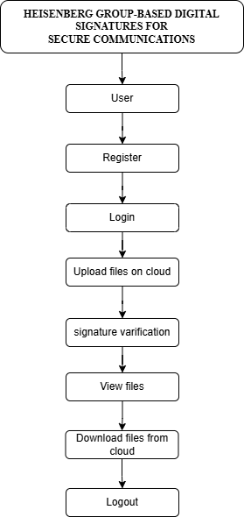
PROJECT FLOW

Slide 16
ADVANTAGES
Enhanced Security: By leveraging EdDSA (Edwards-Curve Digital Signature Algorithm), the system offers robust cryptographic security, ensuring data integrity, authenticity, and confidentiality.
Quantum Resistance: EdDSA is more resistant to quantum computing threats compared to traditional algorithms like RSA and ECDSA, making the system future-proof.
Faster Performance: EdDSA provides faster signature generation and verification than older algorithms, enhancing system efficiency.
Smaller Key Sizes: The use of elliptic curve cryptography ensures smaller key sizes for the same level of security, improving computational efficiency.
Non-Repudiation: The system ensures that once data is uploaded and signed, it cannot be tampered with or denied by the sender, ensuring trust in the data.
Scalability: The system is designed to efficiently handle large volumes of data and users, making it suitable for growing cloud storage needs.
.

Slide 17
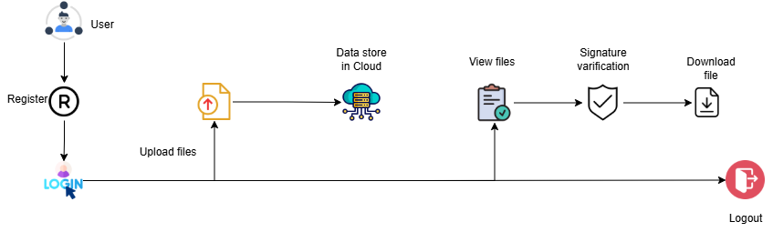
ARCHITECTURE

Slide 18
Implementation:
1. User Module
Functionality: The initial entry point of the system where the user accesses the application.
2. Register Module
Functionality: Allows the user to create a new account by providing necessary details (e.g., username, email, password). This module stores user data in the system's database.
3. Login Module
Functionality: Authenticates users using their registered credentials (username/email and password). After successful authentication, the user is granted access to the system.
4. Upload Files on Cloud Module
Functionality: Enables users to upload various types of files (documents, images, videos, music, etc.) to the cloud storage. The files are securely stored after being signed using Heisenberg group-based digital signatures for security.
5. Signature Verification Module
Functionality: After uploading files, this module verifies the Heisenberg group-based digital signature to ensure the integrity and authenticity of the uploaded files. It checks whether the file has been tampered with during the upload process.

Slide 19
6. View Files Module
Functionality: Allows users to view the list of files that have been uploaded to the cloud. This module provides a user interface to view file metadata or contents (depending on the file type).
7. Download Files from Cloud Module
Functionality: Allows users to download files from the cloud after verifying their authenticity and integrity through digital signatures. This module ensures that the downloaded files are the same as the uploaded ones.
8. Logout Module
Functionality: Ends the user session and securely logs the user out of the system, ensuring that no unauthorized access occurs after the session ends.

Slide 20
HARDWARE AND SOFTWARE REQUIREMENTS
Hardware Requirements
Processor - I3/Intel Processor
Hard Disk - 160GB
Key Board - Standard Windows Keyboard
Mouse - Two or Three Button Mouse
Monitor - SVGA
RAM - 8GB

Slide 21
SOFTWARE SYSTEM CONFIGURATION
Operating System : Windows 7/8/10
Server side Script : HTML, CSS, Bootstrap & JS
Programming Language : Python
Libraries : Django
Technology : Python 3.6+
Database : SQLITE

Slide 22
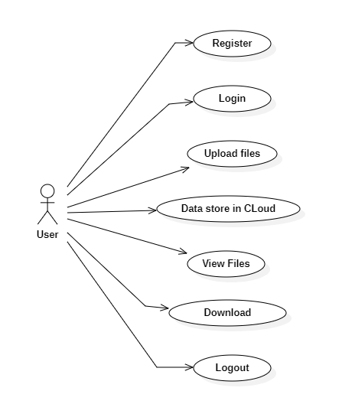
UML Diagrams
The Use Case Diagram for the "Code-Geeks Online Learning Platform" involves two primary actors: Learners and Instructors. Learners can perform various actions such as registering for an account, logging in, enrolling in courses, and browsing available course content. Once enrolled, they can track their progress, participate in coding challenges, submit assignments, and receive real-time feedback from instructors. Learners can also view and download their certificates upon course completion. Additionally, they can interact with instructors and peers through discussion forums or messaging systems.

Slide 23
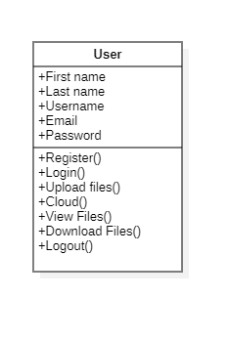
UML Diagrams
Class Diagram:
The UML Class Diagram for the Code-Geeks Online Learning Platform provides a detailed overview of the system's structure, focusing on key components such as User, Learner, Instructor, and Course. Each class in the diagram is represented by a box divided into three sections: the class name, attributes (data), and methods (functions or operations). The User class serves as the parent class, containing common attributes like userID, email, and password, which are inherited by both the Learner and Instructor classes.

Slide 24
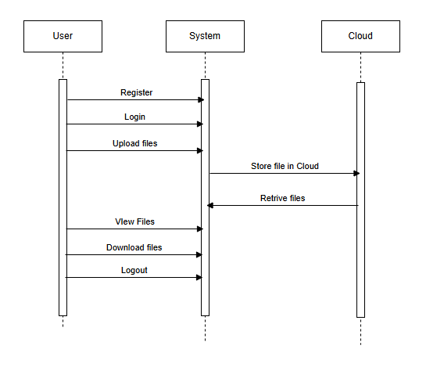
UML DIAGRAMS
A Sequence Diagram for the Code-Geeks Online Learning Platform illustrates the interaction between various system components over time, showcasing how users (learners and instructors) and the system collaborate to perform tasks. The diagram begins with the Learner initiating a login request by providing valid credentials to the system. The System verifies the credentials by interacting with the Database to check the learner’s details. If the credentials are valid, the learner gains access to their personalized dashboard, which displays available courses, progress tracking, and course.

Slide 25
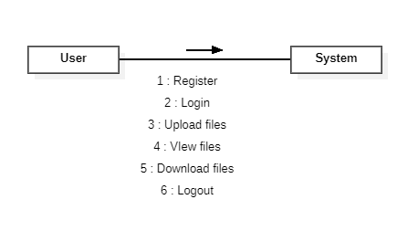
UML DIAGRAMS
The Collaboration Diagram for the Code-Geeks Online Learning Platform describes the interactions between the various system components (objects) to achieve specific tasks, emphasizing how these objects collaborate to complete a function. In this platform, the Learner and Instructor are the primary actors, while the System, Database, and Course objects play crucial roles in facilitating these interactions.

Slide 26
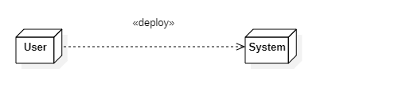
UML DIAGRAMS
The Deployment Diagram for the Code-Geeks Online Learning Platform illustrates the physical deployment of the system's components and how they interact across different nodes or servers. The diagram involves several key components, such as the Learner's Device, Instructor's Device, Web Server, Application Server, and Database Server, each representing a node in the system. At the user end, the Learner's Device and the Instructor's Device are the primary clients that interact with the platform. These devices, which could be desktops, laptops, or mobile devices, access the platform via a web browser or a mobile app.

Slide 27
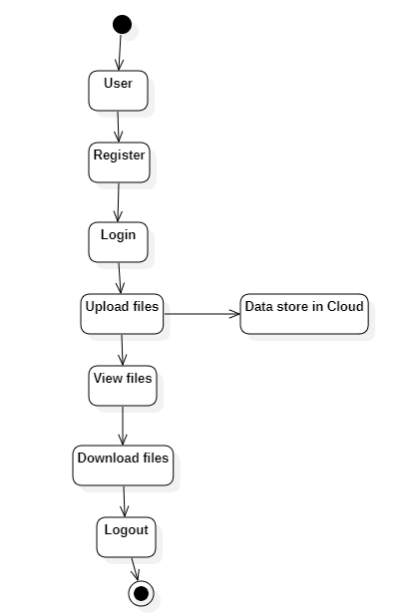
UML DIAGRAMS
The Activity Diagram for the Code-Geeks Online Learning Platform illustrates the flow of activities and actions performed by users (learners and instructors) and the system throughout their interactions with the platform. The diagram begins with the Learner or Instructor accessing the platform, either by logging into their account or registering as a new user. The system checks the credentials or registration details, and if valid, the user is granted access to their personalized dashboard.

Slide 28
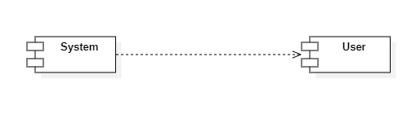
UML DIAGRAMS
The Component Diagram for the Code-Geeks Online Learning Platform provides a high-level view of the system’s components and how they interact with each other. The diagram breaks down the platform into several core components, each responsible for specific functionality. These components work together to deliver the various features required by learners, instructors, and administrators.

Slide 29
UML DIAGRAMS
ER Diagram:
The Entity-Relationship (ER) Diagram for the Code-Geeks Online Learning Platform provides a visual representation of the system's key entities, their attributes, and the relationships between them. The diagram outlines the main entities involved in the platform, including User, Course, Instructor, Learner, Assignment, and Feedback, and describes how they are interconnected to manage user data, course content, and performance tracking. The User entity serves as the parent entity and has attributes such as userID, email, password, and role (either learner or instructor). The Learner and Instructor entities inherit from the User entity. The Learner entity includes additional attributes such as progress, enrollmentDate, and certificationStatus, while the Instructor entity has attributes like instructorID, bio, and specialization.

Slide 30
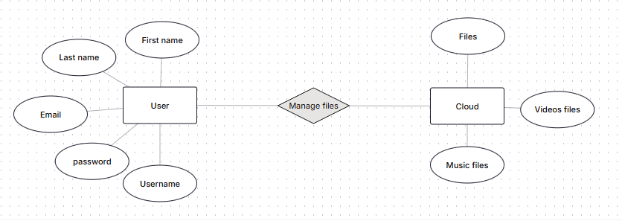
ER DIAGRAMS

Slide 31
UML DIAGRAMS
DFD Diagram:
The Data Flow Diagram (DFD) for the Code-Geeks Online Learning Platform illustrates the flow of information between various processes and components within the system. It highlights how data is collected, processed, and outputted, providing a clear representation of the system's functionality and the interactions between users (learners and instructors) and the platform.
At the highest level (Level 0), the DFD depicts the entire system as a single process, with external entities such as Learners, Instructors, and the Database. The Learners interact with the system by submitting login credentials, browsing available courses, enrolling, completing assignments, and receiving feedback.

Slide 32
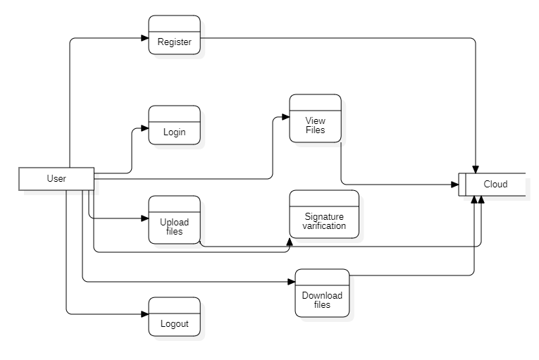
DFD DIAGRAMS
DFD level-1 diagram

Slide 33
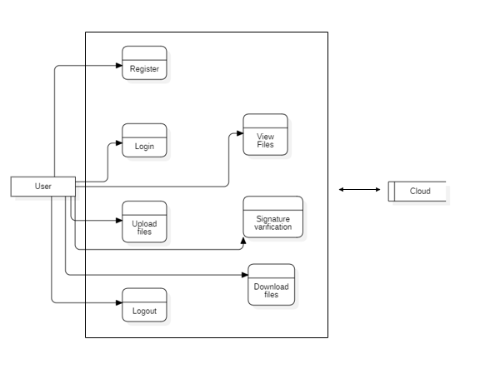
DFD DIAGRAMS
Figure:Level-2 diagram

Slide 34
CONCLUSION
In this project, a secure cloud storage system was developed using EdDSA (Edwards-Curve Digital Signature Algorithm) to provide robust data protection. By leveraging the non-commutative properties of EdDSA, the system ensures data integrity, authenticity, and confidentiality, making it resistant to both traditional and emerging cryptographic attacks, including those posed by quantum computing. The solution not only addresses current security challenges but also prepares for future threats, offering enhanced security and scalability. With faster signature generation and verification, the system ensures efficient performance while maintaining high security. Additionally, the user-friendly interface enables seamless data upload, retrieval, and management. Overall, this project provides a secure, scalable, and quantum-resistant solution for cloud storage, ensuring the long-term protection of sensitive data in an increasingly digital world.

Slide 35
FUTURE ENHANCEMENT
Several enhancements can be introduced to improve the security, scalability, and usability of the cloud storage system. Adding Multi-Factor Authentication (MFA) would provide an extra layer of security during user login and document access. Role-Based Access Control (RBAC) could enable administrators to manage access to documents based on user roles, ensuring that sensitive data is restricted to authorized users. Implementing a file versioning system would allow users to track and revert to previous versions of uploaded files, especially useful in collaborative environments. Combining EdDSA with symmetric encryption algorithms like AES for hybrid encryption could enhance performance by enabling faster file encryption while maintaining strong security. Audit logging would track all document activities for accountability and transparency. Additionally, integration with multiple cloud providers such as AWS, Google Cloud, and Azure would offer users flexibility in secure data storage. Lastly, performance optimization techniques would ensure that the system can handle large-scale data and a high number of concurrent users without compromising security or efficiency.

Slide 36
REFERANCES
Rongxing Lu, Xingliang Yuan, and Xiaodong Lin, “Homomorphic Encryption for Cloud Computing: An Overview.” IEEE Communications Surveys & Tutorials, 2021. This paper provides an overview of homomorphic encryption, focusing on its application in cloud computing and the challenges it faces in practical implementations.
Dongsheng Li, Qingxu Li, and Shanshan Li, “A Survey on Post-Quantum Cryptography: Algorithms and Implementations.” IEEE Access, 2021. This survey explores post-quantum cryptographic algorithms, their applications, and their resistance to quantum computing.
David J. Bernstein, Tanja Lange, and Christiane Peters, “Post-Quantum Cryptography: A New Era for Secure Communication.” Nature Communications, 2020. The paper examines the growing need for post-quantum cryptography and provides an overview of current and emerging quantum-resistant algorithms.
Wei Zhang, Xuefeng Liu, and Xiang Liu, “AES Encryption in Modern Cryptography: A Survey.” International Journal of Computer Science and Network Security, 2020. This paper surveys the AES encryption standard, its applications, and the challenges faced with AES encryption in modern cryptographic systems.
Yuval Ishai, Erez Petrank, and Guy N. Rothblum, “Cryptographic Signatures Based on the Heisenberg Group.” Journal of Cryptology, 2019. The paper introduces cryptographic signatures based on the Heisenberg group, providing a quantum-resistant approach to digital signature schemes.

Slide 37
REFERANCES
Shachar Itzhaky, Ori Shai, and Adi Shamir, “Quantum-Resistant Digital Signature Schemes: An Overview.” IEEE Transactions on Information Forensics and Security, 2021. This paper provides an overview of quantum-resistant digital signature schemes, highlighting their potential to secure digital communications in a quantum computing era.
Jian Guo, Shuangyong Yuan, and Neng Yu, “Post-Quantum Cryptographic Digital Signature Schemes: A Survey.” Journal of Cryptographic Engineering, 2020. This article surveys various post-quantum digital signature schemes, analyzing their security and performance under quantum computing threats.
Xiaoyan Li, Xiaodong Lin, and Anni Qiao, “Efficient Quantum-Resistant Digital Signature Schemes for Blockchain.” International Journal of Information Security, 2020. The paper discusses quantum-resistant digital signature schemes, specifically focusing on their application in blockchain environments.
Rafael K. Guyon, “An Overview of Quantum Cryptography and Its Application to Secure Communications.” IEEE Transactions on Quantum Engineering, 2021. This paper provides a comprehensive overview of quantum cryptography and its potential applications in securing digital communications in a quantum future.
Amit K. Ghosh, Amit Agarwal, and Sandeep K. Garg, “Quantum Safe Digital Signature Schemes and Their Applications in Blockchain.” IEEE Access, 2020. This paper discusses quantum-safe digital signature schemes, with a focus on their use in blockchain technology for secure transactions.

